Slide 1
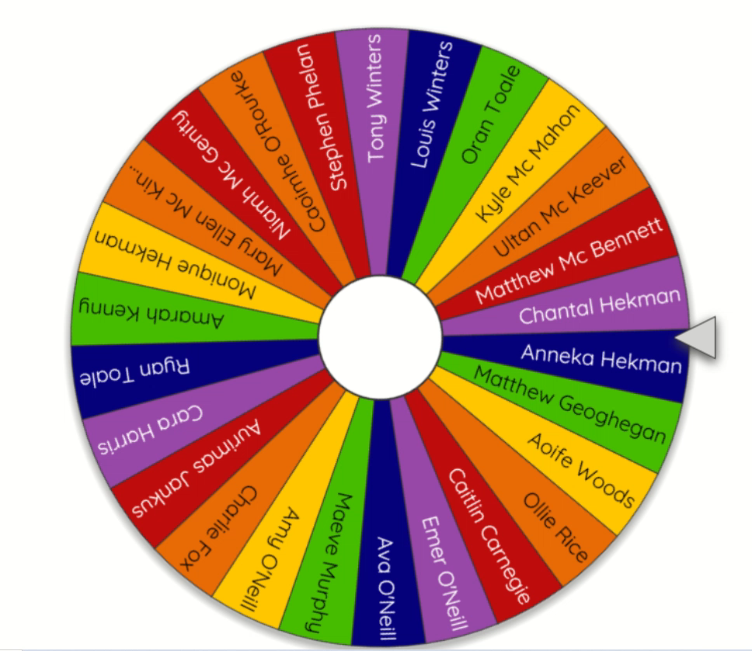
Mathletics Gold Certificate Prize Draw
https://wheelofnames.com/
Collect your prize in school the day of the book drive through!

