Slide 1
Birds in our Townland
By Ruth-Alice

Slide 2
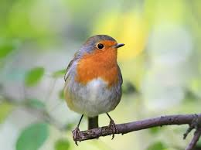
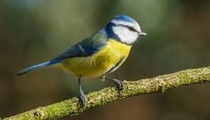
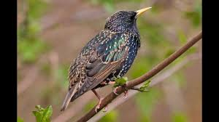
Robin : I see this in my garden almost every day. They are different sizes, some look bigger than others. They sound like this: https://www.british-birdsongs.uk/european-robin/
Blue Tit: this hops about, it comes to feeders in Granny’s house, they nest in holes in trees but might nest in a letter box or lampposts. https://www.british-birdsongs.uk/blue-tit/
Starling: These make a sound like a bomb falling and like chattering teeth. They sit on telephone wires: https://www.british-birdsongs.uk/common-starling/

Slide 3
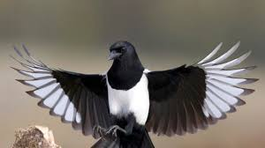
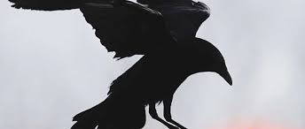
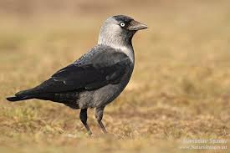
Magpie; they are known for liking shiny stuff, they and are noisy animals they are a bit like crows apart from the whiteness. https://www.british-birdsongs.uk/common-magpie/
Crow; they are very noisy birds, and like to snatch food that you put out for them. They are clever birds. They eat dead animals. https://www.british-birdsongs.uk/carrion-crow/
Hooded crow; scares off other smaller birds, and is like crows but has grey like a hood which gives it it’s name. https://www.british-birdsongs.uk/hooded-crow/

Slide 4
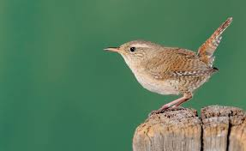
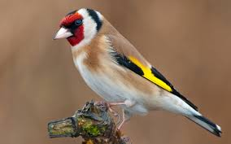
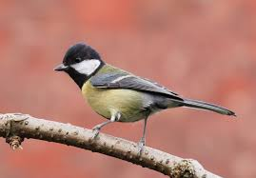
Wren: Has a sticky up tail. People call it Jenny Wren. https://www.british-birdsongs.uk/wren/
Goldfinch: sounds a bit like a Great Tit but adds a machine gun sound. https://www.british-birdsongs.uk/goldfinch/
Great Tit: their song sounds like a rusty gate squeaking 3 times. https://www.british-birdsongs.uk/eurasian-great-tit/

Slide 5
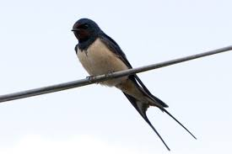
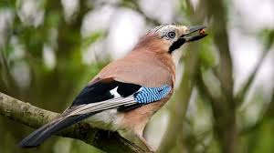
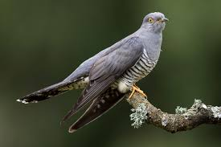
Swallow: they build their nests on the side of houses. https://www.british-birdsongs.uk/barn-swallow/
Jay: a member of the crow family. They eat acorns and nuts. https://www.british-birdsongs.uk/jay/
Cuckoo: we heard this on Granda’s farm, but we didn’t see it. It lays its eggs in other bird’s nests. https://www.british-birdsongs.uk/common-cuckoo/

Slide 6
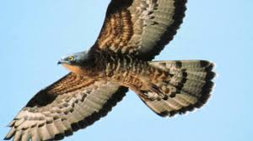
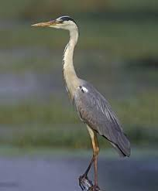
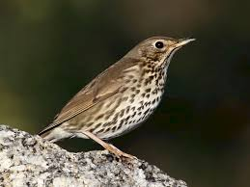
Buzzard: we saw these close to Dromintee school and on the bog road. https://www.british-birdsongs.uk/common-buzzard/
Heron: lives in the river in Forkhill. It ducks its head into the water to catch fish. https://www.british-birdsongs.uk/grey-heron/
Song Thrush: does lots of different sounds. It eats snails by breaking the shells on rocks. https://www.british-birdsongs.uk/song-thrush/

Slide 7
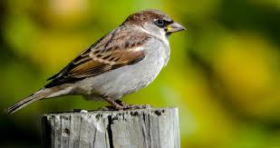
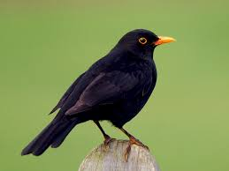
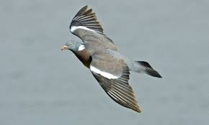
Sparrow: they build nests on houses on the gables, they are scared of crows. https://www.british-birdsongs.uk/house-sparrow/
Blackbird: only the boy is black. They eat insects, worms and berries. https://www.british-birdsongs.uk/common-blackbird/
Wood Pigeon: you might mistake its call for an owl’s call. Daddy says it reminds him of WWII aeroplanes because of the stripes. https://www.british-birdsongs.uk/common-wood-pigeon/

Slide 8
This recording was taken in our local area, see how many birds you can recognise.

